Slide 1
Unit 4: Input/Output Management
Kapil Dev Pant

Slide 2
Contents
Principles of I/O Hardware
I/O Device
Device Controller
Memory Mapped I/O
Direct Memory Access
Principles of I/O Software
Goals of I/O Software,
Polled I/O verses Interrupt Driven I/O,
Character User Interface and Graphical User Interface,
Device Driver,
Device Independent I/O Software,
User space I/O Software
3. Mass Storage Structure
Overview of Mass Storage Structure,
Disk Structure,
Disk Attachment,
Disk Scheduling,
Disk Management,
Swap space Management
Redundant Array of Inexpensive Disks ,
RAM Disks,
Optical Disk

Slide 3
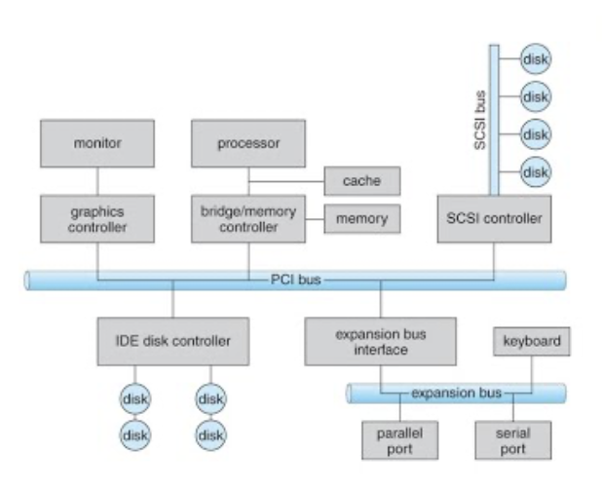
Input Output Management
Input/Output Management refers to the process of handling data inputs and outputs in a computer system.
Essential to ensure communication between core components and external devices
OS acts as a manager between hardware
devices and user programs.
Notes:
I/O Management is a function of the Operating System that controls and coordinates all input and output devices (keyboard, mouse, disk, printer, network, display, etc.) so that programs can use them efficiently, safely, and without conflicts
This management is essential to ensure efficient communication between the system’s core components (such as CPU and memory) and external devices (like keyboards, storage devices, printers, and networks).

Slide 4
Why I/O Management is Needed?
Without I/O management:
Programs would need to know device hardware details
Multiple processes might try to use the same device at once
Data transfer would be slow, unsafe, and error-prone
With I/O management:
Hardware complexity is hidden
Devices are shared safely
System performance improves
Goals of I/O Management
Device Independence
Programs don’t need to know how a device works
Same read/write commands for different devices
Efficiency
Reduce CPU waiting time
Use buffering, caching, and DMA
Protection & Security
Prevent unauthorized device access
Error Handling
Detect and recover from I/O errors

Slide 5
Principles of IO Hardware
I/O Devices
Human readable
Machine readable
Communication devices
Device controllers
I/O Ports
Memory Mapped IO vs Port mapped IO
Polling
Interrupts
DMA
Error Detection and Handling
IO Hardware Performance Considerations
Notes:
Input/Output (I/O) hardware provides the physical interface between the computer system and external devices such as keyboard, mouse, disk, printer, and network cards. The design of I/O hardware follows certain principles to ensure efficiency, flexibility, and reliability.
1. I/O Devices
I/O devices are classified based on their functionality:
(a) Human-Readable Devices
Used for interaction with users
Examples: Keyboard, mouse, monitor, printer
(b) Machine-Readable Devices
Used for data storage and communication
Examples: Disk drives, sensors, network interface cards
(c) Communication Devices
Used for data transfer between systems
Examples: Modems, routers, NICs
2. Device Controllers
A device controller is an electronic component that manages a specific I/O device.
Functions:
Accepts commands from the CPU
Controls the operation of the device
Converts serial data to parallel and vice-versa
Maintains control and status registers
Importance:
Acts as an interface between CPU and I/O device
Offloads low-level device control from the CPU
3. I/O Ports
I/O ports are addresses through which the CPU communicates with device controllers.
Types:
Data port – transfers data
Status port – provides device status
Control port – sends commands
Ports allow the CPU to read/write data and control signals efficiently.
4. Memory-Mapped I/O vs Port-Mapped I/O
Memory-Mapped I/O
Device registers are mapped into memory address space
CPU accesses devices using normal load/store instructions
Faster and more flexible
Port-Mapped I/O
Separate I/O address space
Special I/O instructions are required
Example: IN, OUT instructions
5. Polling
In polling, the CPU repeatedly checks the device status to determine readiness.
Working:
CPU checks status register
If device is busy, CPU keeps waiting
Transfers data when ready
Advantages:
Simple implementation
Disadvantages:
Wastes CPU time (busy waiting)
6. Interrupts
Interrupts allow the device to notify the CPU when it needs attention.
Working:
CPU initiates I/O operation
Device performs operation independently
Device generates interrupt upon completion
CPU executes Interrupt Service Routine (ISR)
Advantages:
Efficient CPU utilization
Suitable for slow devices
7. Direct Memory Access (DMA)
DMA allows devices to transfer data directly between memory and device, without CPU involvement.
Working:
CPU initializes DMA controller
DMA controller transfers data
CPU is interrupted after completion
Advantages:
High-speed data transfer
Reduces CPU overhead
Usage:
Disk drives
Network cards
8. Error Detection and Handling
I/O hardware includes mechanisms for:
Parity checks
CRC (Cyclic Redundancy Check)
Time-out detection
Errors are reported to the OS for corrective action.
9. I/O Hardware Performance Considerations
Key performance factors:
Data transfer rate
Latency
Reliability
Scalability
Efficient I/O hardware design improves overall system throughput.
The principles of I/O hardware focus on standardization, efficiency, and flexibility. Techniques like interrupts and DMA reduce CPU load, while device controllers simplify hardware interaction. Together, these principles ensure smooth and reliable I/O operations in modern operating systems.

Slide 6
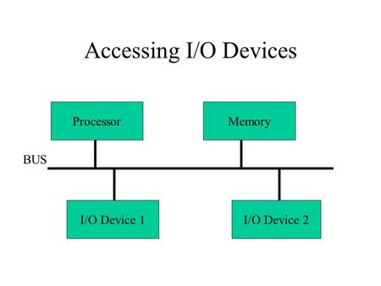
I/O Device
These are the devices that communicate with a computer system by sending signals over a cable.
The devices use a common set of wires, called bus, for communication
I/O devices can be of two types:
Block Device: A device which stores information in fixed size blocks, each one with its own address is termed as block device.
Common block size – 512 – 32,768 bytes.
Example: Disks are the most common block devices.
Character Device: A character device delivers or accepts a stream of characters, without regard to any block structure.
Example: printer, mouse, etc.
Notes:
I/O Devices
Examples:
Input: Keyboard, Mouse, Scanner
Output: Monitor, Printer
Storage: Hard disk, SSD
Communication: Network card

Slide 7
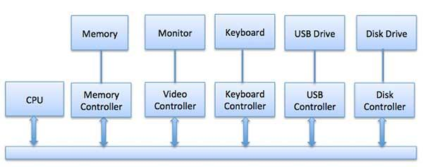
Device Controller
A chip or circuit board that controls functioning of IO.
Device drivers are software modules that can be plugged into an OS to handle a particular device.
Works like an interface between a device and a device driver.
It takes care of low-level operations such as error checking, moving disk heads, data transfer, and location of data on the device.
Example: serial port controller,
SCSI bus controller, disk controller
Notes:
I/O units (Keyboard, mouse, printer, etc.) typically consist of a mechanical component and an electronic component where electronic component is called the device controller.
There is always a device controller and a device driver for each device to communicate with the Operating Systems.

Slide 8
Function of device controllers
Stops and starts the activity of the peripheral device.
Generate error checking code.
Checks the error in the data received from the interface.
Abort that command which have errors.
Retry the command having an error
Receives the control signals from the interface unit
Convert the format of the data
Check the status of the device
Notes:
1. Stops and starts the activity of the peripheral device
Explanation: The I/O controller controls when a device should begin or stop an operation based on commands from the OS.
Example:
When you click Print, the printer controller starts printing
After printing finishes, it stops the printer motor
OS → Printer driver → Printer controller → Start/Stop device
2. Generate error checking code
Explanation: Before sending data to a device, the controller generates error-detecting codes to ensure data integrity.
Common codes:
Parity bit
Checksum
CRC (Cyclic Redundancy Check)
Example:
While sending data to a hard disk, the disk controller generates a CRC code and appends it to the data
3. Checks the error in the data received from the interface
Explanation: When data is received, the controller verifies it using the error-checking code.
Example:
Network card receives a data packet
Controller recalculates CRC
If CRC ≠ received value → error detected
4. Abort that command which have errors
Explanation: If an error is detected and recovery is not possible, the controller terminates (aborts) the current command.
Example:
Disk read operation fails due to a bad sector
Controller aborts the read command and reports error to OS
5. Retry the command having an error
Explanation: Instead of immediately failing, the controller may automatically retry the operation.
Example:
Disk read fails once
Controller retries reading the same sector
If successful → data is accepted
If not → error is reported
This improves reliability.
6. Receives the control signals from the interface unit
Explanation: The device controller receives control signals/commands such as:
Read
Write
Reset
Stop
from the interface unit / OS.
Example:
OS sends a READ command
Disk controller receives it and starts disk rotation
7. Convert the format of the data
Explanation: Devices and computers may use different data formats, so conversion is required.
Example:
Keyboard sends scan codes
Controller converts scan codes → ASCII characters
OS receives readable characters
Another example:
Analog signal (microphone) → digital data
8. Check the status of the device
Explanation: The controller continuously monitors and reports device status.
Common status values:
Busy
Ready
Idle
Error
Example:
Printer status:
Busy → currently printing
Ready → waiting for job
Error → paper jam
OS reads status register to decide next action

Slide 9
I/O Classification
Data Transfer Methods
Programmed I/O
Interrupt-driven I/O
DMA
Device Addressing Methods
Memory-mapped I/O
Port-mapped / Isolated I/O

Slide 10
Device Addressing Methods
How devices are addressed?
Port-mapped / Special-instruction I/O : Uses separate I/O address space, IN/OUT instructions
Memory-mapped I/O : Devices share memory address space, CPU uses normal instructions

Slide 11
Special Instruction IO| Port mapped IO | Isolated IO
Devices have a separate I/O address space.
This uses CPU instructions (IN & OUT) that are specifically made for controlling I/O devices.
These instructions typically allow data to be sent to an I/O device or read from an I/O device.
It maintains a separate address space for I/O devices, distinct from main memory
This method offers simple, explicit control over devices, often used for specific register access, but requires special, often slower commands compared to memory-mapped I/O.
Widely Used in : Embedded Systems, Microcontrollers, Real time Systems
Notes:
Port-mapped I/O is an input/output technique in which I/O devices are accessed using a separate address space called the I/O port space.
This address space is different from the main memory address space.
Because of this separation, the CPU uses special I/O instructions to communicate with devices instead of normal memory instructions.
Memory and I/O have separate address spaces, and I/O is accessed via ports.
Key Aspects of Special Instruction I/O:
Dedicated Instructions: Uses specialized assembly instructions (e.g., IN for reading, OUT for writing) to transfer data between CPU registers and I/O devices.
Separate Address Space: The I/O address space is distinct from the physical memory address space, meaning a address (X) in memory is different from address (X) in I/O.
Controlled Access: Typically used in Intel architectures for accessing device data, status, or command registers.
Efficiency for Simple Devices: It is ideal for simple, low-speed devices, but can be less efficient than DMA (Direct Memory Access) for high-speed devices.
Usage Context: While memory-mapped I/O allows any memory instruction to access devices, special instruction I/O requires specific commands.
Embedded systems often use isolated I/O because it's important to keep the CPU and peripheral devices completely separate. This includes things like industrial control systems, robotics, and automotive electronics. Keeping devices separate helps prevent issues with one device from affecting the whole system.
Microcontrollers often use isolated input and output to connect with different devices like sensors, actuators, and screens. Each device gets its own special input/output port, which lets the microcontroller talk to several different parts connected to it, one at a time, in a smooth and effective way. In real-time systems, where timing is very important and the system needs to act in a predictable way, isolated I/O is usually used. It lets you have exact control over when things happen and how they line up with each other, which helps the system work reliably and in a predictable way.

Slide 12
How Port-Mapped I/O Works
Each I/O device is assigned a unique port number (or range of port numbers).
The CPU places the port address on the address bus.
Special control signals indicate an I/O operation (not a memory operation).
Data is transferred between CPU registers and the I/O device.
In port-mapped I/O, normal load/store instructions cannot be used.
Common instructions (especially in x86 architecture):
IN 🡪 Read data from an I/O port
OUT 🡪 Write data to an I/O port
Example:
IN AL, 60H ; Read data from keyboard port
OUT 378H, AL ; Send data to printer port

Slide 13
Advantages and Disadvantages
Advantages:
Clear separation between memory and I/O
Memory space is fully available for programs
Simple and efficient for basic devices
Easy to control I/O operations.
Disadvantages:
Limited number of I/O ports
Extra instructions needed
Not portable across all CPU architectures
Less flexible than memory-mapped I/O

Slide 14
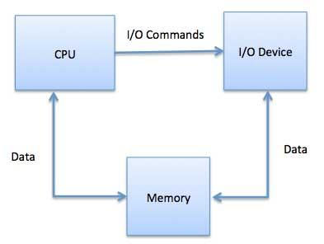
Memory Mapped I/O
Technique used in computer systems to communicate with I/O devices by mapping their control and data registers into the system's main memory address space.
This allows the CPU to interact with these devices using standard memory instructions.
Working of Memory-Mapped I/O:
Devices have control registers and data registers
These registers are assigned specific memory addresses.
The CPU reads from or writes to these addresses to
perform I/O operations.
Applications
Modern computer systems (like x86 and ARM architectures)
MMIO is common in embedded systems.
Notes:
It is the scheme that assigns specific memory location to I/O devices. For example, in memory mapped display text character drives its data from a specific location. Thus communication to and from I/O device can be same as reading and writing to memory address that responds to the I/O devices.

Slide 15
Data Transfer Method (Communication to IO devices)
Who moves the data?
There are three types:
Programmed / Polled I/O: CPU continuously checks device status and transfers data
Interrupt-driven I/O: CPU transfers data only after device sends interrupt
Direct Memory Access (DMA): DMA controller transfers data directly, CPU free

Slide 16
Polled IO (Programmed IO)
Polled I/O is an input/output technique in which the CPU repeatedly checks the status of an I/O device to determine whether it is ready to perform a data transfer.
The CPU remains actively involved during the entire I/O operation.
Characteristics of Polled I/O:
CPU continuously monitors the device
No interrupts are used
Simple control mechanism
CPU remains blocked until I/O completes

Slide 17
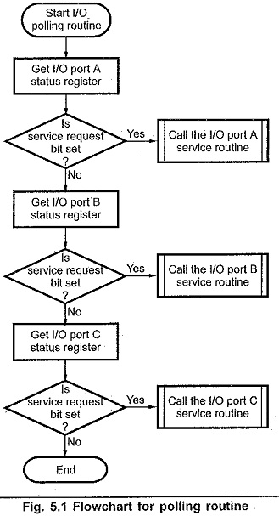
Working of Polled IO
The CPU issues an I/O command to the device controller.
The CPU continuously checks (polls) the status register of the device.
If the device is busy, the CPU keeps waiting (busy waiting).
When the device becomes ready, the CPU transfers data.
The operation ends after successful data transfer.
Notes:
This is a simple program which services I/O ports A, B, and C. The polling routine checks the status of I/O ports in proper sequence. It first transfers the status of I/O port A into the accumulator. Then the polling routine block checks the contents of accumulator to see if the service request bit is set. If it is, I/O port A service routine is called.
After completion of service routine for I/O port A, the polling routine moves on to test port B and the process is repeated. This test and service procedure continues until all the I/O port status registers are tested and all the I/O ports requesting service are serviced. Once this is done, the microprocessor continues to execute the normal programs
The polling routine assigns priorities to the different I/O devices. Once the polling routine is started, the service request bit at port A is always checked first. Once port A is checked, port B is checked, and then port C. However, the order can be changed by simply changing the polling routine and thus the priorities.

Slide 18
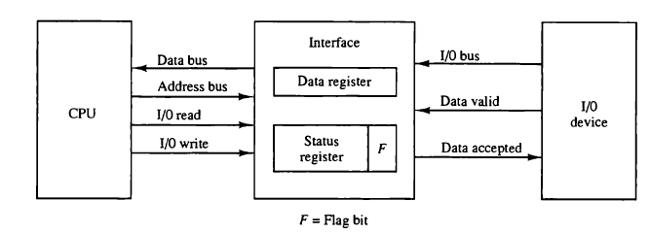
Applications
Simple embedded systems
Microcontrollers
Devices requiring frequent checking
Systems with few I/O devices

Slide 19
Advantages and Disadvantages
Advantages
Simple implementation
Easy hardware and software design
Predictable behavior
Useful for real-time or embedded systems
No interrupt overhead
Eliminates context switching due to interrupts
Disadvantages
Wastes CPU time
CPU is idle while polling
Poor performance
Inefficient for slow devices
Not suitable for multitasking systems
Notes:
Polled I/O is a basic I/O technique where the CPU actively waits for the device to become ready. Although it is simple and easy to implement, it is inefficient due to busy waiting and is rarely used in modern multitasking operating systems, where interrupt-driven I/O is preferred.

Slide 20
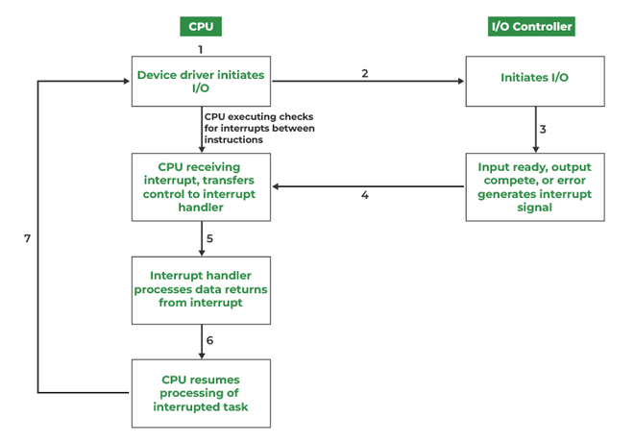
Interrupt Driven IO
It is a signal emitted by hardware or software when a process or an event needs immediate attention.
It alerts the processor to a high-priority process requiring interruption of the current working process.
dedicated control line is called the Interrupt Service Routine (ISR).
Notes:
An interrupt is a signal that causes the CPU to temporarily stop executing the current program and execute a special routine called the Interrupt Service Routine (ISR).
Interrupts are classified based on source, timing, and handling method.

Slide 21
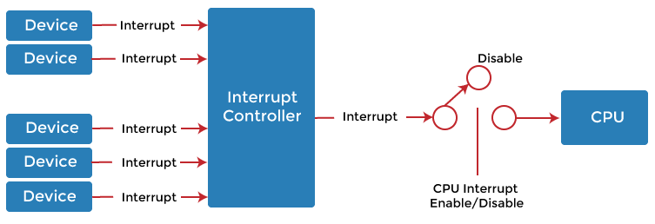
Interrupt Controller
Manages interrupt requests (IRQs) generated by I/O devices and delivers them to the CPU in an organized and prioritized manner.
It acts as an intermediate unit between interrupt-generating devices and the processor
Notes:
Need for an Interrupt Controller
Multiple devices may request service simultaneously
CPU can handle only one interrupt at a time
Interrupts must be:
Prioritized
Masked (enabled/disabled)
Acknowledged correctly
The interrupt controller solves these problems.
Functions of Interrupt Controller
Collects interrupt requests from I/O devices
Prioritizes interrupts when multiple requests occur
Masks interrupts (enables/disables selected IRQs)
Sends interrupt signal to CPU
Provides interrupt vector number
Handles interrupt acknowledgement from CPU
Working of Interrupt Controller
An I/O device generates an interrupt request (IRQ).
The interrupt controller receives the IRQ.
It checks:
Whether the interrupt is enabled
Its priority level
The highest-priority interrupt is forwarded to the CPU.
CPU sends an interrupt acknowledge (INTA) signal.
Interrupt controller supplies the interrupt vector.
CPU executes the corresponding Interrupt Service Routine (ISR).
Interrupt Priority Handling
Interrupts are assigned priority levels.
Higher-priority interrupts can:
Preempt lower-priority ones
Priority schemes:
Fixed priority
Rotating priority
Programmable priority

Slide 22
Types of Interrupt
Types of interrupt
Hardware interrupt
Software interrupt
Other classifications
Maskable
Normal interrupts
External interrupts (due to IO devices)
Non maskable
Exceptions
Periodic/aperiodic
Notes:
1. Hardware Interrupts (External) Generated by physical peripherals or external signals requiring CPU attention.
Maskable Interrupts (MI): Can be delayed or ignored by the CPU if higher-priority tasks are running.
Non-Maskable Interrupts (NMI): Cannot be ignored; must be serviced immediately (e.g., power failure, hardware failure).
2. Software Interrupts (Internal) Generated by programs or instructions, often to request operating system services.
Normal Interrupts: Specific instructions within a program that trigger an interrupt.
Exceptions: Unplanned interruptions caused by errors during instruction execution (e.g., division by zero, invalid memory access).
3. Other Classifications
External Interrupts: Triggered by I/O devices, timers, or hardware failures.
Internal Interrupts :Caused by illegal or erroneous use of instructions (similar to exceptions).
Periodic/Aperiodic: Occurring at fixed intervals (timer) or unpredictably (mouse click).
Common Examples:
I/O Interrupt: Printer finished printing, keyboard key press.
Timer Interrupt: A process timer reaches zero.
System Call: A program requesting data from the disk.
Hardware Interrupts
In a hardware interrupt, all the devices are connected to the Interrupt Request Line. A single request line is used for all the n devices. To request an interrupt, a device closes its associated switch. When a device requests an interrupt, the value of INTR is the logical OR of the requests from individual devices.
Hardware interrupts are further divided into two types of interrupt
Maskable Interrupt: Hardware interrupts can be selectively enabled and disabled thanks to an inbuilt interrupt mask register that is commonly found in processors. A bit in the mask register corresponds to each interrupt signal; on some systems, the interrupt is enabled when the bit is set and disabled when the bit is clear, but on other systems, the interrupt is deactivated when the bit is set.
Spurious Interrupt: A hardware interrupt for which there is no source is known as a spurious interrupt. This phenomenon might also be referred to as phantom or ghost interrupts. When a wired-OR interrupt circuit is connected to a level-sensitive processor input, spurious interruptions are typically an issue. When a system performs badly, it could be challenging to locate these interruptions.
Software Interrupt:
A sort of interrupt called a software interrupt is one that is produced by software or a system as opposed to hardware. Traps and exceptions are other names for software interruptions. They serve as a signal for the operating system or a system service to carry out a certain function or respond to an error condition. Generally, software interrupts occur as a result of specific instructions being used or exceptions in the operation. In our system, software interrupts often occur when system calls are made. In contrast to the fork() system call, which also generates a software interrupt, division by zero throws an exception that results in the software interrupt.
A particular instruction known as an "interrupt instruction" is used to create software interrupts. When the interrupt instruction is used, the processor stops what it is doing and switches over to a particular interrupt handler code. The interrupt handler routine completes the required work or handles any errors before handing back control to the interrupted application.

Slide 23
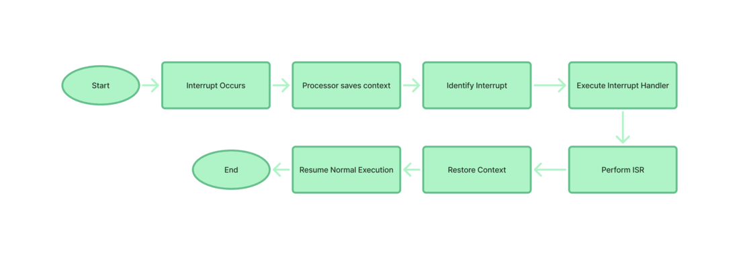
Interrupt handling mechanism
Devices raise an IRQ.
The processor interrupts the program currently being executed.
The device is informed that its request has been recognized and the device deactivates the request signal.
The requested action is performed.
An interrupt is enabled and the interrupted program is resumed
Notes:
Step 1:- Any time that an interrupt is raised, it may either be an I/O interrupt or a system interrupt.
Step 2:- The current state comprising registers and the program counter is then stored in order to conserve the state of the process.
Step 3:- The current interrupt and its handler is identified through the interrupt vector table in the processor.
Step 4:- This control now shifts to the interrupt handler, which is a function located in the kernel space.
Step 5:- Specific tasks are performed by Interrupt Service Routine (ISR) which are essential to manage interrupt.
Step 6:- The status from the previous session is retrieved so as to build on the process from that point.
Step 7:- The control is then shifted back to the other process that was pending and the normal process continues.

Slide 24
Polling Vs Interrupt
Basis | Polling | Interrupt
Definition | CPU repeatedly checks the status of the I/O device | Device notifies CPU when it needs attention
CPU Involvement | CPU is continuously involved | CPU is involved only when interrupt occurs
Waiting Mechanism | Busy waiting | No busy waiting
Efficiency | Low | High
CPU Utilization | Poor (CPU time wasted) | Good (CPU does useful work)
Response Time | Depends on polling frequency | Immediate response
Complexity | Simple to implement | More complex
Overhead | No interrupt overhead | Interrupt handling overhead
Suitable Devices | Fast or simple devices | Slow I/O devices
Multitasking Support | Poor | Excellent
Power Consumption | Higher | Lower
Example | Simple microcontrollers | Keyboard, disk, network I/O
Notes:
Polling
CPU keeps checking the device status register.
If the device is not ready, CPU waits.
Leads to wastage of CPU cycles.
Interrupt
CPU issues I/O command and continues other work.
Device generates an interrupt when ready.
CPU executes Interrupt Service Routine (ISR).
Polling is simple but inefficient, while interrupt-driven I/O is efficient and widely used in modern operating systems. Interrupts allow better CPU utilization and support multitasking, making them suitable for most real-world systems.

Slide 25
Direct Memory Access (DMA)
It is a feature used in computer systems to allow I/O devices to transfer data directly to or from the main memory without continuous CPU involvement.
DMA module itself controls exchange of data between main memory and the I/O device.
CPU is only involved at the beginning and end of the transfer and interrupted only after entire block has been transferred.
CPU
Main Memory
Data Bus
DMA
Device Controller
Device Controller
Device Controller
USB Drive
Disk
Printer
Notes:
DMA (Direct Memory Access) DMA Stands for "Direct Memory Access." DMA is a method of transferring data from the computer's RAM to another part of the computer without processing it using the CPU. While most data that is input or output from your computer is processed by the CPU, some data does not require processing, or can be processed by another device. In these situations, DMA can save processing time and is a more efficient way to move data from the computer's memory to other devices. In other words, direct memory access (DMA) is a method that allows an input/output (I/O) device to send or receive data directly to or from the main memory, bypassing the CPU to speed up memory operations. The process is managed by a chip known as a DMA controller (DMAC). For example, a sound card may need to access data stored in the computer's RAM, but since it can process the data itself, it may use DMA to bypass the CPU. Video cards that support DMA can also access the system memory and process graphics without needing the CPU DMA is an essential feature of all modern computers, as it allows devices to transfer data without subjecting the CPU to a heavy overhead. With DMA, the CPU gets freed from this overhead and can do useful tasks during data transfer. A DMA Controller is a device, which takes over the system bus to directly transfer information from one part of the system to another. The DMA controller is told to make a transfer either by the CPU or some special circumstances; then the DMA controller makes a request to gain control of the bus from the CPU, other processors, or controllers which might currently be using bus; these other devices then relinquish control of the bus by putting their lines into tri-state condition; they then grant the bus to the DMA controller; and finally, the DMA controller takes over the bus, generating its own address and control signals for the bus and causing the transfer of information.

Slide 26
Direct Memory Access (DMA)
Types of Direct Memory Access (DMA)
Single-Ended DMA: reading and writing from a single memory address.
Dual-Ended DMA: read and write from two memory addresses.
Arbitrated-Ended DMA: reading and writing to several memory addresses.
Interleaved DMA: read from one memory address and write from another memory address.
Modes of Data Transfer in DMA
Burst Mode: In this buses are handed over to the CPU by the DMA if the whole data is completely transferred.
Cycle Stealing Mode: In this buses are handed over to the CPU by the DMA after the transfer of each byte
Transparent Mode: does not require any bus in the transfer of the data as it works when the CPU is executing the transaction.

Slide 27
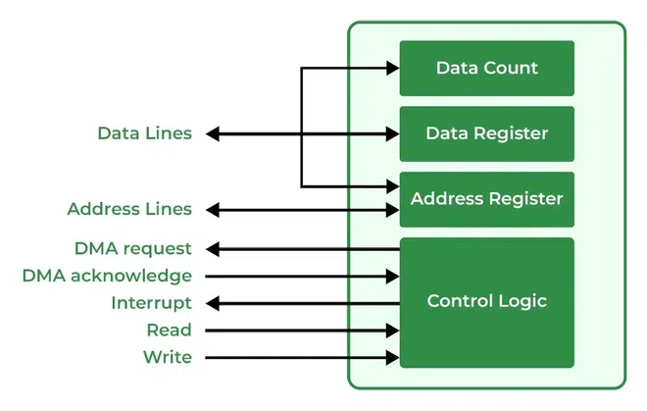
DMA Controller

Slide 28
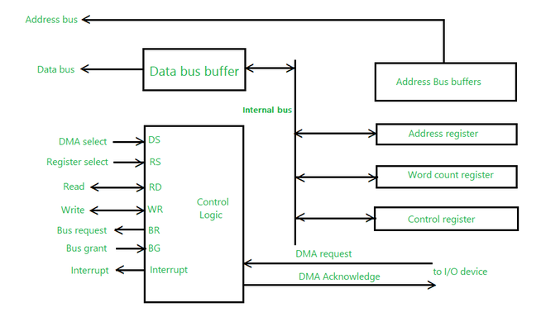
Working of DMA Controller

Slide 29
Principles of I/O Software
I/O software provides a layered interface between application programs and I/O hardware.
The main goal of I/O software is to hide hardware complexity, provide a uniform interface, and ensure efficient, reliable, and secure I/O operations.
The principles of I/O software aim to provide simplicity, efficiency, reliability, and protection.
By hiding hardware details and using techniques like buffering, caching, spooling, and device independence, I/O software ensures smooth interaction between applications and hardware in modern operating systems.

Slide 30
Goals of IO Software
I/O software acts as a bridge between hardware devices and user programs. Its main goals are:
Device Independence
Uniform Naming
Error Handling
Buffering
Sharing Devices
Protection and Access Control
It manages device drivers, handles errors, optimizes performance through buffering and caching, and supports both shared and dedicated devices.
Notes:
Device Independence
One of the most important principles of I/O software is device independence.
Application programs should not need to know the type or details of I/O devices.
The same program should work with different devices without modification.
Example: read(file) works the same whether the file is on HDD, SSD, or USB drive.
Benefit: Improves portability and simplifies application development.
2. Uniform Naming
I/O software provides uniform and consistent names for devices.
Devices are accessed using logical names rather than physical identifiers.
OS maps logical names to physical devices.
Example:
Linux: /dev/sda, /dev/tty
Windows: COM1, LPT1
Benefit: Makes device access simple and consistent.
3. Error Handling
I/O software must detect and handle errors as close to the hardware as possible.
Types of Errors:
Read/write failure
Device not responding
Data corruption
Handling:
Device drivers handle hardware-specific errors.
OS reports errors to applications in a standard form.
Benefit: Improves reliability and system stability.
Synchronous and Asynchronous I/O
Synchronous I/O
Process waits until I/O operation completes.
Simple but inefficient.
Asynchronous I/O
Process continues execution after initiating I/O.
OS notifies process upon completion.
Benefit: Asynchronous I/O improves CPU utilization and performance.
Buffering
Buffering stores data temporarily in memory during I/O operations.
Purpose:
Match speed differences between CPU and devices
Reduce number of I/O operations
Improve throughput
Types:
Single buffering
Double buffering
Circular buffering
Example: Keyboard buffer stores keystrokes before processing.
Caching
Caching stores frequently used data in fast memory.
Read operations are faster if data is cached.
Reduces access to slow devices like disks.
Example: Disk block cache in OS.
Spooling
Spooling (Simultaneous Peripheral Operations On-Line) allows one device to serve multiple processes.
Example:
Print spooling: print jobs stored on disk and printed one by one.
Benefit:
Increases device utilization
Eliminates direct competition for slow devices
Sharing Devices
Allows multiple processes to share devices safely.
Example:Multiple users printing documents using a print queue.
Kernel Mode and User Mode Separation
Low-level I/O operations run in kernel mode
User programs access devices via system calls
Benefit:
Prevents unauthorized or incorrect hardware access
Improves system security
Protection and Access Control
Prevent unauthorized access to devices.
Example:Ordinary users cannot directly access disk hardware.

Slide 31
Overview of Mass Storage Structure
Mass storage provides permanent data storage
Data is non-volatile (retained without power)
Essential for OS, applications, and user data
Need for Mass Storage
RAM is limited and volatile
Store operating system files
Store applications and user data
Support virtual memory (swap space)
Backup and recovery
Notes:
Mass storage refers to secondary storage devices used to store large amounts of data permanently. Unlike main memory (RAM), mass storage is non-volatile, meaning data is not lost when power is turned off. It is essential for storing the operating system, applications, and user data.
Purpose of Mass Storage
Mass storage is used to:
Store the operating system and system files
Store user data and applications
Support virtual memory (swap space)
Provide backup and archival storage
Characteristics of Mass Storage
Non-volatile (data persists without power)
Large capacity (GBs to TBs)
Lower cost per bit compared to RAM
Slower access speed than main memory
Accessed via I/O controllers and device drivers
Disk Structure (Core Part)
A magnetic disk is organized as:
Platters – circular disks coated with magnetic material
Tracks – concentric circles on each platter
Sectors – smallest addressable unit (usually 512 bytes or 4 KB)
Cylinders – set of tracks at the same position on all platters
Mass Storage and Operating System
The OS manages mass storage using:
Device drivers
Disk scheduling algorithms (FCFS, SSTF, SCAN, etc.)
File systems (NTFS, EXT4, FAT32)
Swap space management
Disk management (partitioning, formatting)
Importance of Mass Storage Structure
Enables persistent data storage
Supports multitasking and virtual memory
Improves system reliability and performance
Allows large-scale data processing
Mass storage structure is a fundamental component of an operating system. It provides permanent data storage, supports efficient system operation, and ensures data reliability through structured organization and OS-level management.

Slide 32
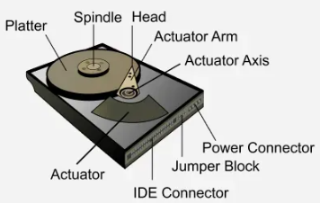
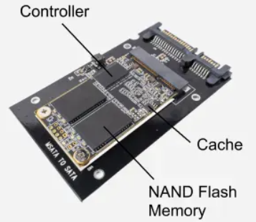
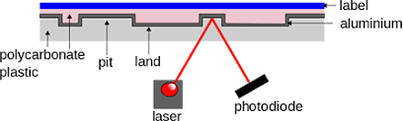
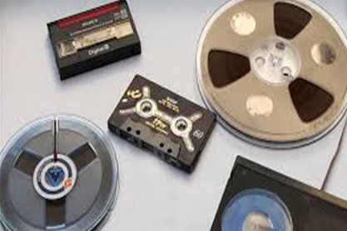
Types of Mass Storage Devices
Magnetic Disk (HDD)
Solid State Drive (SSD)
Optical Disks
Magnetic Tape
High Storage capacity
Data stored on rotating magnetic platters
Random access storage
Used as primary secondary storage
Example: Internal hard disks
Uses flash memory,
Faster than HDD, no moving parts
Lower latency and power consumption
CD, DVD, Blu-ray
Used mainly for distribution and backups
Sequential access
Used for backup and archival purposes
Notes:
Types of Mass Storage Devices
Magnetic Disks
Hard Disk Drives (HDD)
High Storage capacity
Data stored on rotating magnetic platters
Random access storage
Used as primary secondary storage
Example: Internal hard disks
Solid State Drives (SSD)
Uses flash memory,
Faster than HDD, no moving parts
Lower latency and power consumption
Optical Disks
CD, DVD, Blu-ray
Used mainly for distribution and backups
Magnetic Tape
Sequential access
Used for backup and archival purposes

Slide 33
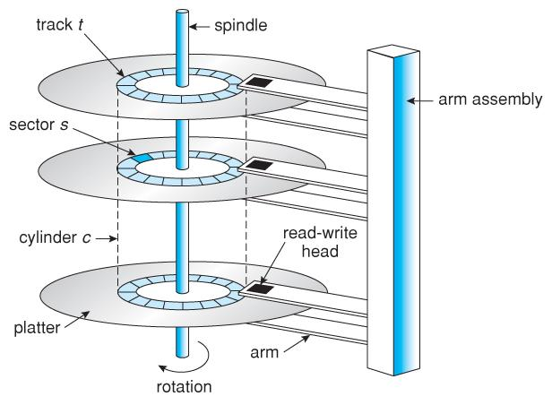
Disk Structure
Animation on Disk Structure
A disk is a secondary storage device used to store large amounts of data permanently.
To manage data efficiently, a disk is organized into a well-defined physical and logical structure.
Physical Structure
Platters
Spindle
Read Write heads
Logical Structure
Tracks
Sectors
Cylinders
Notes:
1. Physical Structure of Disk
Physically, a disk consists of the following components:
a) Platters
A disk is made up of one or more circular platters.
Platters are coated with a magnetic material used to store data.
Multiple platters are stacked vertically and rotate together.
b) Spindle
The spindle is the central shaft on which platters are mounted.
It rotates all platters at a constant speed (e.g., 5400 RPM, 7200 RPM).
c) Read/Write Heads
Each platter surface has a read/write head.
Heads move radially across the platter to access data.
Data is read or written magnetically without direct contact.
2. Logical Structure of Disk
To organize data logically, the disk surface is divided into smaller units:
a) Tracks
A track is a circular path on the surface of a platter.
Each platter surface contains thousands of tracks.
b) Sectors
Each track is divided into smaller units called sectors.
A sector is the smallest physical storage unit on the disk.
Typical sector size: 512 bytes or 4 KB.
c) Cylinders
A cylinder is a set of tracks at the same radius across all platters.
Accessing data within a cylinder is faster because the head position does not change.
3. Disk Addressing
Data on the disk is accessed using an address:
Traditionally: Cylinder–Head–Sector (CHS)
Modern systems use Logical Block Addressing (LBA), where:
Each sector is given a unique number.
OS accesses data using these block numbers.
4. Disk Blocks
The operating system views the disk as a sequence of logical blocks.
A block may consist of one or more sectors.
File systems allocate disk space in terms of blocks.
5. Disk Access Time Components
The disk structure directly affects access time, which includes:
Seek Time – Time to move the head to the correct track.
Rotational Latency – Time waiting for the desired sector to rotate under the head.
Transfer Time – Time to transfer data to/from memory.
Importance of Disk Structure
Helps the OS locate data efficiently.
Minimizes access time using proper scheduling.
Supports file systems and disk management operations.
Essential for techniques like disk scheduling, RAID, and caching.

Slide 34
Disk Attachment
Method by which secondary storage devices (disks) are connected to a computer system
Role of Disk Attachment in OS
Determines I/O performance
Affects file system behavior
Influences scalability and reliability
Helps in distributed and cloud storage
Types of Disk
Attachment
Host-Attached Storage
Network-Attached Storage (NAS)
Storage Area Network
(SAN)
IDE/PATA
NVMe (over PCLe)
Fibre Channel
InfiniBand
SCSI
SATA
NFS (Linux/UNIX)
SMB/CIFS (Windows)
SCSI
Notes:
Disk attachment refers to the method by which secondary storage devices (disks) are connected to a computer system so that the operating system can access and manage them.
Types of Disk Attachment
1. Host-Attached Storage
In host-attached storage, the disk is directly connected to the computer system.
Features
Disk communicates directly with the CPU via I/O controllers
Appears as a local disk to the OS
Simple and low cost
Common Interfaces
IDE / PATA
SATA
SCSI
NVMe (over PCIe)
Examples
Internal HDDs
SSDs inside laptops/desktops
Advantages
High performance
Low latency
Simple configuration
Disadvantages
Limited sharing between systems
Scalability is low
2. Network-Attached Storage (NAS)
In NAS, disks are connected to a dedicated storage device that is accessed over a network.
Features
Uses file-level access
Appears as a shared folder
Uses network protocols
Protocols Used
NFS (Linux/UNIX)
SMB/CIFS (Windows)
Examples
File servers
Home and enterprise NAS devices
Advantages
Easy file sharing
Centralized storage
OS-independent access
Disadvantages
Slower than local disks
Network dependency
3. Storage Area Network (SAN)
A SAN provides block-level disk access over a high-speed network.
Features
Disk appears as a local disk to the OS
Uses dedicated storage networks
High performance and reliability
Technologies Used
Fibre Channel
iSCSI
InfiniBand
Examples
Enterprise data centers
Virtualized environments
Advantages
Very high speed
High scalability
Supports clustering
Disadvantages
Expensive
Complex setup and maintenance

Slide 35
Comparison of Disk attachment methods
Feature | Host-Attached | NAS | SAN
Connection | Direct | Network | Dedicated network
Access type | Block-level | File-level | Block-level
Performance | High | Moderate | Very high
Sharing | Limited | Easy | Complex but powerful
Cost | Low | Medium | High

Slide 36
Redundant Array of Independent Disks (RAID)
combines multiple physical drives into one or more logical units for data redundancy, improved performance, or both.
distributes data across drives using methods like striping (speed) or mirroring (fault tolerance)
Common levels include RAID 0, 1, 5, and 10, typically managed by a hardware controller or software within the operating system.
Purpose: Enhances reliability, increases storage capacity, and boosts read/write speeds.
Functionality: It treats multiple drives as a single logical volume, managing data to prevent loss if one drive fails.
Notes:
RAID (Redundant Array of Independent Disks) is a data storage virtualization technology that combines multiple physical drives into one or more logical units for data redundancy, improved performance, or both.

Slide 37
Types of RAID
Hard ware
Software

Slide 38
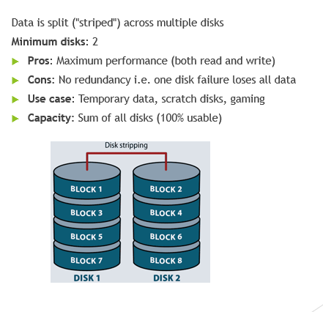
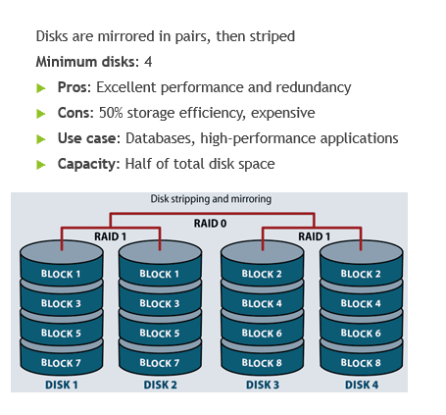
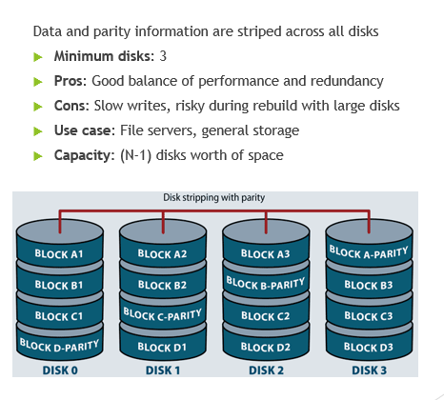
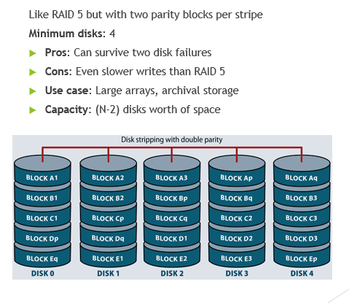
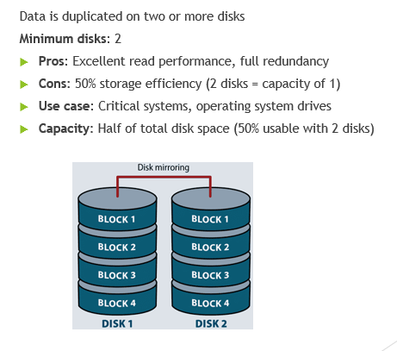
Different RAID levels
CLICK ME
RAID 0
RAID 1
RAID 1+0
RAID 5
RAID 6
Notes:
Data striping, i.e. data is divided into multiple blocks and saved in multiple disks in parallel.
Multiple Data blocks can be fetched at the same time boosting performance
It offers the best performance, but it does not provide fault tolerance

Slide 39
Different RAID levels
RAID 0
Notes:
Data striping, i.e. data is divided into multiple blocks and saved in multiple disks in parallel.
Multiple Data blocks can be fetched at the same time boosting performance
It offers the best performance, but it does not provide fault tolerance

Slide 40
Different RAID levels
RAID 1
Notes:
Data striping, i.e. data is divided into multiple blocks and saved in multiple disks in parallel.
Multiple Data blocks can be fetched at the same time boosting performance
It offers the best performance, but it does not provide fault tolerance

Slide 41
Different RAID levels
RAID 1+0
Notes:
Data striping, i.e. data is divided into multiple blocks and saved in multiple disks in parallel.
Multiple Data blocks can be fetched at the same time boosting performance
It offers the best performance, but it does not provide fault tolerance

Slide 42
Different RAID levels
RAID 5
Notes:
Data striping, i.e. data is divided into multiple blocks and saved in multiple disks in parallel.
Multiple Data blocks can be fetched at the same time boosting performance
It offers the best performance, but it does not provide fault tolerance

Slide 43
Different RAID levels
RAID 6
Notes:
Data striping, i.e. data is divided into multiple blocks and saved in multiple disks in parallel.
Multiple Data blocks can be fetched at the same time boosting performance
It offers the best performance, but it does not provide fault tolerance

Slide 44
Disk Scheduling
Disk scheduling algorithms manage how data is read from and written to a computer's hard disk.
The main goals are to optimize the performance of disk operations; reduce the time it takes to access data and improve overall system efficiency.
Key Components:
Seek Time: Seek time is the time taken to locate the disk arm to a specified track where the data is to be read or write.
Rotational Latency: time taken by the desired sector of disk to rotate into a position
Transfer Time: time to transfer the data. depends on the rotating speed of the disk and number of bytes to be transferred.
Disk Access Time: Seek Time + Rotational Latency +Transfer Time
Disk Response Time: Average of time spent by a request waiting to perform its I/O operation.
Notes:
Disk scheduling is done by operating systems to schedule I/O requests arriving for the disk. Disk scheduling is also known as I/O scheduling. Disk scheduling is important because:
• Multiple I/O requests may arrive by different processes and only one I/O request can be served at a time by the disk controller. Thus other I/O requests need to wait in the waiting queue and need to be scheduled.
• Two or more request may be far from each other so can result in greater disk arm movement.
• Hard drives are one of the slowest parts of the computer system and thus need to be accessed in an efficient manner.
There are many Disk Scheduling Algorithms but before discussing them let’s have a quick look at
some of the important terms:
• Seek Time: Seek time is the time taken to locate the disk arm to a specified track where the data is to be read or write. So the disk scheduling algorithm that gives minimum average seek time is better.
• Rotational Latency: Rotational Latency is the time taken by the desired sector of disk to rotate into a position so that it can access the read/write heads. So the disk scheduling algorithm that gives minimum rotational latency is better.
• Transfer Time: Transfer time is the time to transfer the data. It depends on the rotating speed of the disk and number of bytes to be transferred.
• Disk Access Time: Disk Access Time is: Disk Access Time = Seek Time + Rotational Latency +Transfer Time
Disk Response Time: Response Time is the average of time spent by a request waiting to perform its I/O operation. Average Response time is the response time of the all requests. Variance Response Time is measure of how individual request are serviced with respect to average response time. So the disk scheduling algorithm that gives minimum variance response time is better.

Slide 45
Disk Scheduling Algorithms
FCFS : Requests are addressed the order they arrive in disk queue.
SSTF :Requests that have the shortest seek time are executed first.
SCAN : Moves in particular direction and request coming in its path are served, after reaching to end its reverse its direction and again served requests in its path.
CSCAN:
LOOK: moves in particular direction, but does not reach in end, only up to the last request in front of head. And then reverses its direction.
CLOOK :

Slide 46
First Come First Serve
In FCFS, the requests are addressed in the order they arrive in the disk queue. Order of request is: (95,169,33,137,26,9,188) and current position of Read/Write head is: 55
Seek Time = (95 – 55) + (169-95)+ (169 – 33) + ….+ (188 - 9) =
0
9
26
33
55
95
100
137
150
169
188
199
55
95
169
33
137
26
9
188

Slide 47
Shortest Seek Time First (SSTF)
Requests with shortest seek time are executed first, so seek time is calculated in advance.
Suppose the order of request is- (95,169,33,137,26,9,188) And current position of Read/Write head is: 55
Seek Time = (55 - 9) + (188 - 9) =
0
9
26
33
55
95
100
137
150
169
188
199
55
33
26
95
9
137
169
188

Slide 48
LOOK Algorithm
Disk goes to the last request to be serviced in front of the head and then reverses its direction from there only
Suppose the order of request is- (95,169,33,137,26,9,188) And current position of Read/Write head is: 55
Seek Time = (188 - 55) + (188 - 9) =
0
9
26
33
55
95
100
137
150
169
188
199
55
95
137
169
188
33
26
9

Slide 49
CLOOK Algorithm
Disk goes only to the last request to be serviced in front of the head and then reverses its direction from there only
Suppose the order of request is- (95,169,33,137,26,9,188) And current position of Read/Write head is: 55
Seek Time = (188 - 55) + (188 - 9)+ (33 – 9) =
0
9
26
33
55
95
100
137
150
169
188
199
55
95
137
169
188
9
26
33

Slide 50
SCAN Algorithm
after reaching the end of the disk, it reverses its direction
Disk not only goes to the last request to be serviced in front of the head but at the end of the list and then reverses its direction from there only.
Suppose the order of request is- (95,169,33,137,26,9,188) And current position of Read/Write head is: 55
Seek Time = (199 - 55) + (199 - 16) =
0
9
26
33
55
95
100
137
150
169
188
199
55
95
137
169
188
33
199
26
9

Slide 51
CSCAN Algorithm
Disk not only goes to the last request to be serviced in front of the head but at the end of the list and then reverses its direction from there only.
Suppose the order of request is- (95,169,33,137,26,9,188) And current position of Read/Write head is: 55
Seek Time = (199 - 55) + (199 - 0) + (33 - 0) =
0
9
26
33
55
95
100
137
150
169
188
199
55
95
137
169
188
0
199
9
26
33

Slide 52
RAM Disk
RAM disk is a virtual storage location that can be accessed the same as an HDD, SSD, or other flash storage device on a computer.
They are created by partitioning capacity from system memory (RAM) using software.
They provide incredibly fast I/O (read and write) performance, many times faster than today’s fastest SSDs, with wider bandwidth and extremely low latencies.
Working of RAM Disk
The operating system reserves a specific portion of RAM.
This reserved memory is formatted with a file system.
The OS then treats it as a virtual disk drive.
Files stored in a RAM disk can be read and written like normal disk files.
Since RAM is volatile, all data in a RAM disk is lost when the system is powered off, unless explicitly backed up.
Notes:
A RAM Disk is a portion of main memory (RAM) that is treated by the operating system as a secondary storage device. It behaves like a hard disk but offers much faster access speed because it is implemented using RAM.
Characteristics of RAM Disk
Very high speed compared to HDDs and SSDs.
Volatile storage – data disappears after shutdown.
Limited in size by available system RAM.
Requires OS or third-party software support.
No mechanical parts → silent and no wear.

Slide 53
Characteristics and Applications
Characteristics
Very high speed compared to HDDs and SSDs.
Volatile storage – data disappears after shutdown.
Limited in size by available system RAM.
Requires OS or third-party software support.
No mechanical parts, so silent and no wear.
Applications
Storing temporary files (OS temp folders).
Browser cache storage.
Compilation and build directories.
High-speed buffering in servers.
Embedded systems for fast data access.

Slide 54
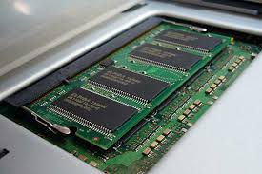
Applications , Advantages and Disadvantages
Advantages
Extremely fast access time
No seek time or rotational latency.
Improves performance for temporary files.
Reduces wear on SSDs by avoiding frequent writes.
Ideal for caching, compilation, and temp storage.
Simple read/write operations.
Disadvantages
Data loss on power failure or reboot.
Reduces available RAM for running programs.
Not suitable for permanent storage.
Requires careful size management.

Slide 55
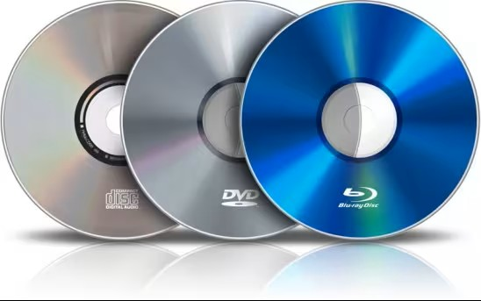
Optical Disks
Stores data in digital form and uses laser light to read and/or write data.
Data is recorded as pits and lands on the disk surface and read by detecting changes in reflected light.
Optical drives work by rotating the disc at a constant speed, measured in RPM (rotation per minute).
The drive uses advanced high-tech laser beams to read and observe the data, and its interface is smaller than computers
Structure of Optical Disk
An optical disk is made up of:
Polycarbonate substrate – base layer of the disk
Reflective layer (aluminum or silver) – reflects laser light
Protective lacquer layer – protects data layer
Label layer
Notes:
Optical disks are laser-based secondary storage devices that store data as pits and lands along a spiral track. Although they offer portability and durability against magnetic interference, their slow speed and limited capacity have reduced their use in modern systems.

Slide 56
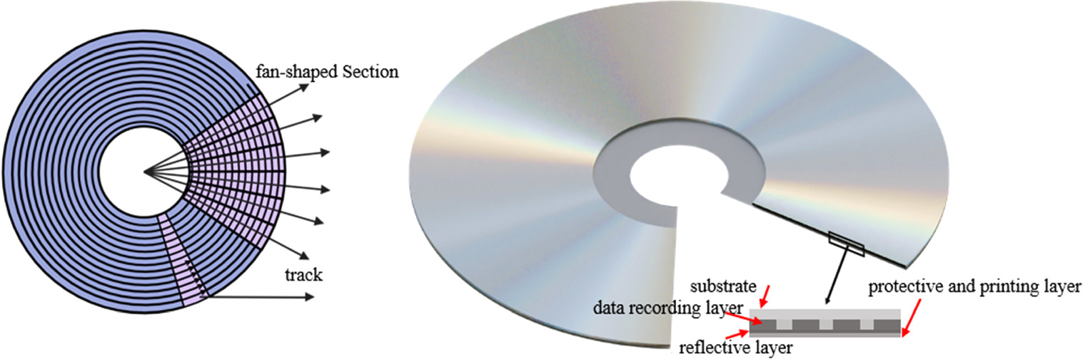
Working Principle
A laser beam is focused onto the disk surface.
Pits (non-reflective areas) and lands (reflective areas) represent binary data (0s and 1s).
Reflected laser light is detected by a photodiode.
Difference in reflection is interpreted as digital data.
Data Organization on Optical Disks
Data is stored along a single continuous spiral track.
Track runs from the center to the outer edge.
Disk is divided into sectors for addressing.
Uses Constant Linear Velocity (CLV).

Slide 57
Different Types of Disks
Features | CD | DVD | Blu-Ray
Storage | 700 MB | 4.7 GB (single layer) | 25 GB (single layer)
Disc diameter | 120mm | 120mm | 120mm
Disc thickness | 1.2mm | 1.2mm | 1.2mm
Hard coating | Yes | Yes | No
Protection layer | 1.2mm | 0.6mm | 1.2mm
Material | Acrylic Plastic | Polycarbonate plastic | Multiple layers of polycarbonate

Slide 58
Memory Wall and Bottleneck
The memory wall refers to the growing performance gap between CPU speed and memory access speed. While CPU speeds have increased exponentially (following Moore's Law), memory speeds have improved at a much slower pace.
Key Problem:
CPU can execute operations in nanoseconds (e.g., 0.3 ns per instruction)
Main memory (RAM) access takes ~100 ns (100-300x slower than CPU operations)
This creates a performance mismatch where CPUs spend most of their time waiting for data

Slide 59
CPU Cycle Time: ~0.3 ns
L1 Cache Access: ~1 ns
L2 Cache Access: ~3-10 ns
L3 Cache Access: ~10-20 ns
Main Memory Access: ~100 ns
Disk Access: ~10,000,000 ns
This hierarchy shows why memory access is a major bottleneck.

Slide 60
The Von Neumann Bottleneck
processor is limited by the rate at which it can transfer data between CPU and memory.
How it manifests:
Shared bus architecture: CPU and memory compete for the same data pathway
Sequential access: Even with parallel processing, memory often provides data sequentially
Bandwidth limitations: Memory bandwidth can't keep up with CPU's data demands

Slide 61
Operating System Implications
Memory Management Challenges:
Page Fault Overhead
When data isn't in RAM (page fault), OS must load from disk
Context switches and disk I/O create massive delays
Example: Page fault penalty = ~10 million CPU cycles
Translation Lookaside Buffer (TLB) Misses
TLB caches virtual-to-physical address translations
TLB misses force expensive page table walks
OS must optimize page table structures and page sizes
Cache Coherence & False Sharing
Multiple CPU cores accessing same memory lines
Cache coherence protocols create overhead
False sharing: Different cores modifying different data in same cache line

Slide 62
Operating System Implications
Scheduling Impacts:
Memory-Aware Scheduling
OS must consider memory access patterns when scheduling threads
NUMA (Non-Uniform Memory Access) architectures require careful thread placement
Example: Placing threads near their frequently accessed memory
Working Set Management
OS must keep each process's "working set" in memory
Thrashing occurs when working sets exceed available RAM
Page replacement algorithms (LRU, Clock, etc.) become critical

Slide 63
Real-World Consequences
Performance Symptoms:
High CPI (Cycles Per Instruction): Due to memory stalls
Low CPU utilization: CPUs idle while waiting for memory
Inconsistent performance: Memory-bound workloads show unpredictable timing
Examples:
Database Systems: Random memory access patterns suffer most
Scientific Computing: Large matrices exceed cache capacities
Virtualization: Multiple VMs competing for limited memory bandwidth

Slide 64
Mitigation Strategies
Hardware Solutions:
Caching hierarchies: L1, L2, L3, LLC (Last Level Cache)
Prefetching: Predict and load data before it's needed
Wider memory buses: Increase data transfer bandwidth
3D-stacked memory: HBM (High Bandwidth Memory) closer to CPU
Operating System Strategies:
Page Coloring
Huge Pages
NUMA-Aware Allocation
Memory Compression
Transparent Huge Pages
Notes:
Operating System Strategies:
Page Coloring
Map pages to specific cache regions
Reduces cache conflicts between processes
Huge Pages
Use 2MB or 1GB pages instead of 4KB
Reduces TLB misses for large memory workloads
NUMA-Aware Allocation
Allocate memory from the same node as the requesting CPU
Tools: numactl on Linux, NUMA APIs on Windows
Memory Compression
Compress less-frequently used pages (zswap in Linux)
Reduces swap I/O at cost of CPU cycles
Transparent Huge Pages
Automatically coalesce small pages into huge pages
Balance between TLB efficiency and memory fragmentation

Slide 65
Future Trends
Processing-in-Memory (PIM)
Perform computations inside memory chips
Reduces data movement
Optical Interconnects
Faster CPU-memory communication
Persistent Memory
Blurring line between memory and storage
New OS memory management challenges
Notes:
OS Developer Considerations:
Minimize cache pollution in kernel code
Use per-CPU data structures to avoid false sharing
Implement efficient page table walkers
Design memory allocators with cache lines in mind
The memory wall and memory bottleneck force OS designers to make sophisticated trade-offs between CPU utilization, memory efficiency, and fairness. Modern operating systems implement complex memory management subsystems specifically to mitigate these issues, but they remain fundamental limitations in computing architecture that require ongoing hardware and software co-design solutions.
Processing in Memory (PIM)
¹
Processing in Memory (PIM) is an innovative approach that aims to bring computation closer to where data is stored, thereby reducing or eliminating the need for data movement between computation units and memory/storage units. This concept is not entirely new, but recent advancements in applications, memory circuits, and technology have significantly increased the need for PIM in modern computing systems.
Key Approaches in PIM
There are two primary approaches to designing PIM systems:
Processing-Using-Memory: This approach leverages the fundamental analog operational principles of memory chips to perform massively-parallel operations directly within the memory. This method can significantly accelerate data-intensive applications by performing computations in-situ in memory.
Processing-Near-Memory: This approach utilizes different logic and memory integration technologies, such as 3D-stacked memory technology, to place computation logic close to memory circuitry. This enables high-bandwidth, low-energy, and low-latency access to data.
Challenges and Solutions
Implementing PIM involves several cross-layer research, design, and adoption challenges across devices, architecture, systems, compilers, programming models, and applications. Some of the key challenges include:
Device and Architecture Design: Developing memory chips and modules that can support in-situ computation without compromising their primary storage functions.
System Integration: Ensuring seamless integration of PIM with existing computing platforms and infrastructure.
Programming Models: Creating programming models and compilers that can efficiently utilize PIM capabilities.
Adoption: Overcoming the shift from a processor-centric to a memory-centric mindset and infrastructure.
Benefits of PIM
Once these challenges are addressed, PIM can offer several benefits, including:
Energy Efficiency: By reducing data movement, PIM can significantly lower energy consumption.
High Performance: PIM can accelerate data-intensive applications by performing computations closer to the data.
Sustainability: PIM can contribute to more sustainable computing systems by improving energy efficiency and performance.
In conclusion, PIM represents a fundamental shift in how computing systems are designed, used, and programmed. By moving computation closer to data, PIM can unleash a new era of energy-efficient, high-performance, and sustainable computing.

Slide 66
Questions

Slide 67
Presentation Topics

